Slide 1
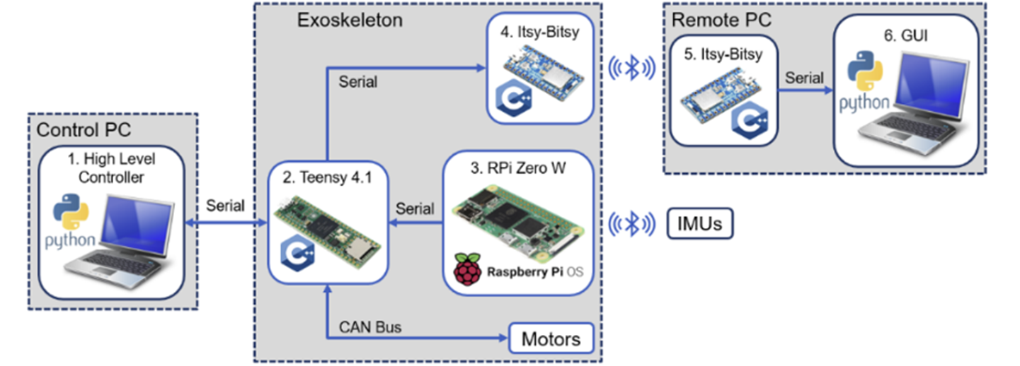
Control Architecture
The folder includes four code scripts. They are, in the order, for:
Teensy 4.1
Itsy-Bitsy (controller side) plugged on the PCB
Itsy-Bitsy (computer side) connected to the Remote PC running the Matlab GUI app
Matlab GUI app on the remote PC

Slide 2
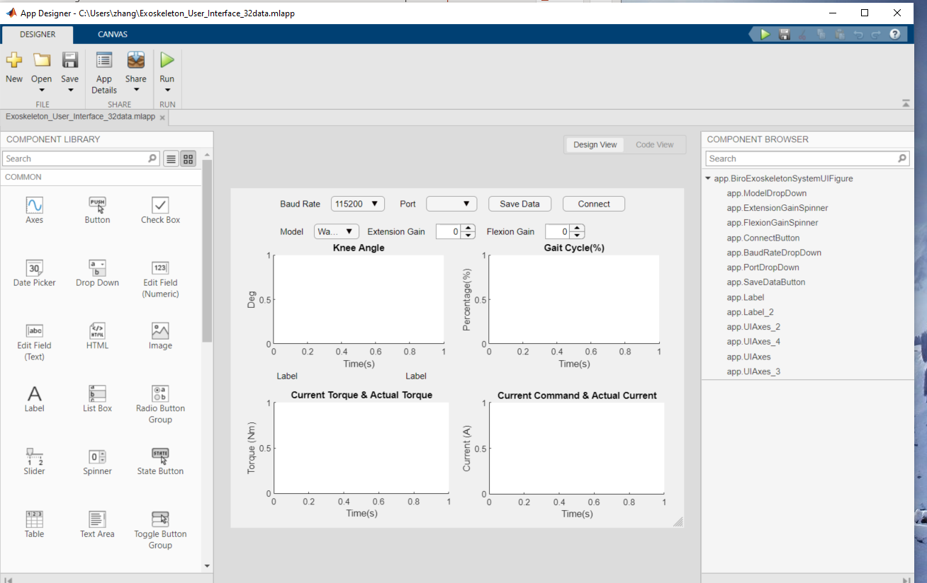
Exo-User Interface MATLAB App
Steps:
Open MATLAB, open Exoskeleton_User_Interface_32data.mlapp
Click ‘run’

Slide 3
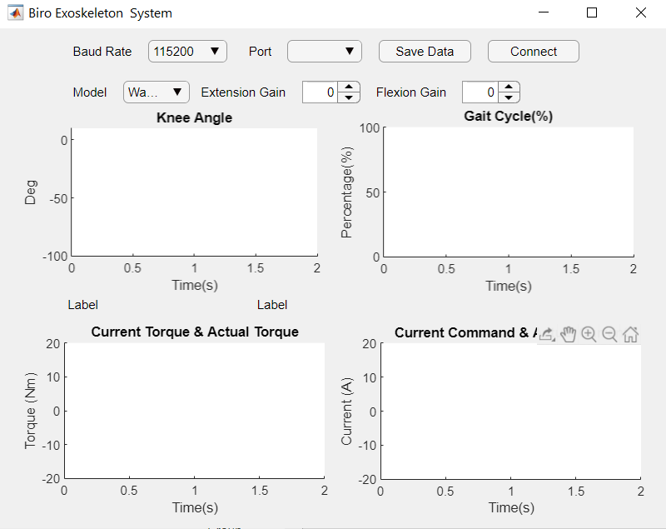
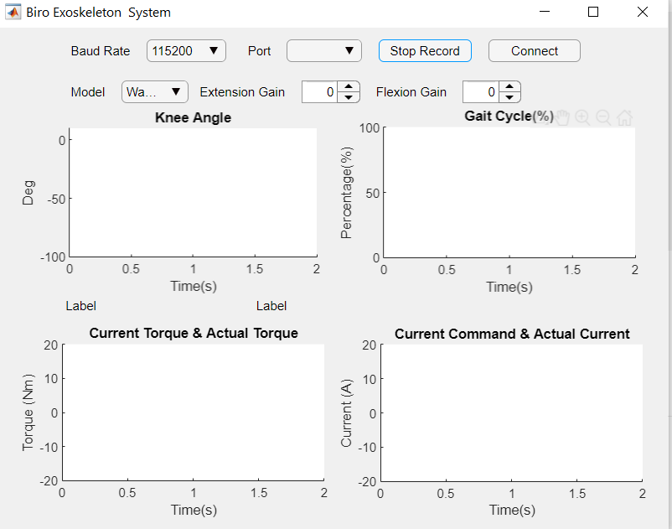
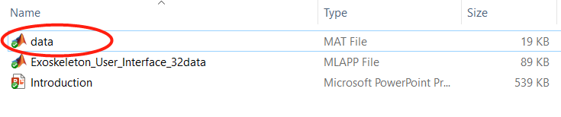
Exo-User Interface MATLAB App
Select the correct port where Itsy-Bitsy (compure side) is connected
Click ‘Connect’ to connect the two Bluetooth receivers (on the two Isty-Bitsy). Bluetooth is used for receiving real-time data and sending control parameters.
Save data: click ‘Save Data’ to begin save, click ‘Stop Save’, all data will be saved at ‘data.mat’. Notes: the ‘data.mat’ will only reserve the latest data.
Data will be saved at here

